Slide 1
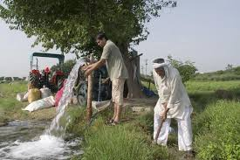
Current Groundwater Governance & Management in India

Slide 2
Layout of Presentation
Ground Water Scenario
Ground water Challenges
Current Governance System
Management Strategies and Initiatives
Suggested GW Governance Reform

Slide 3
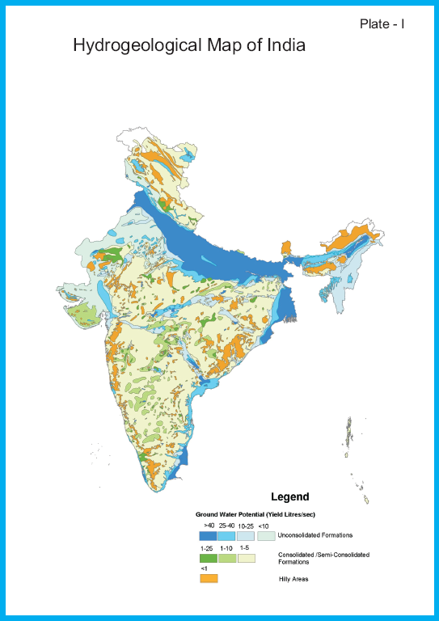
Occurrence of Groundwater
There are two broad groups of water bearing formations depending on their hydraulic properties in the country:
Porous Formations ( cover ~30 % Area)
Unconsolidated
Semi consolidated
Fissured Formations / consolidated formations ( cover ~70 % Area)

Slide 4
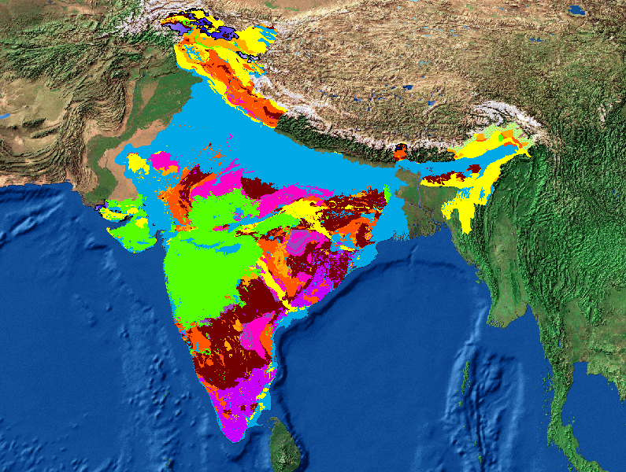
Principal Aquifer Systems in INDIA
(2 Million Scale)
Unconsolidated Sand, silt, gravels, pebbles .
Deccan Basalt and equivalents
Semi consolidated Gondwana Sandstone,
Shale and the equivalents
Igneous intrusives
Consolidated Precambran Sandstone, Shale
and the equivalents
Precambrian Limestone, Dolomite
and the equivalents
Metamorphics
Meta sediments-Schist, Phyllite, Marble etc.
Basement Granite Gneisses

Slide 5
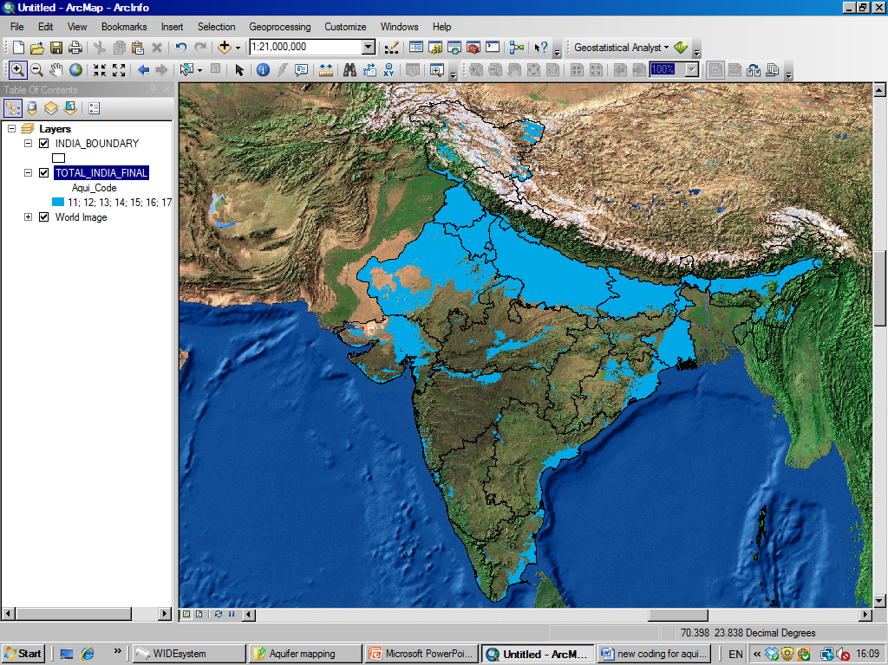
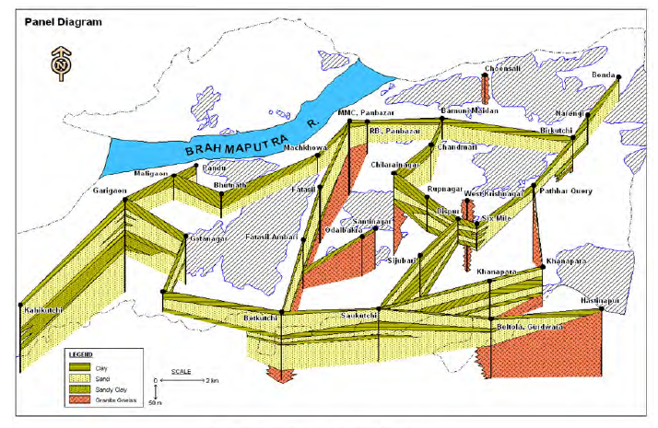
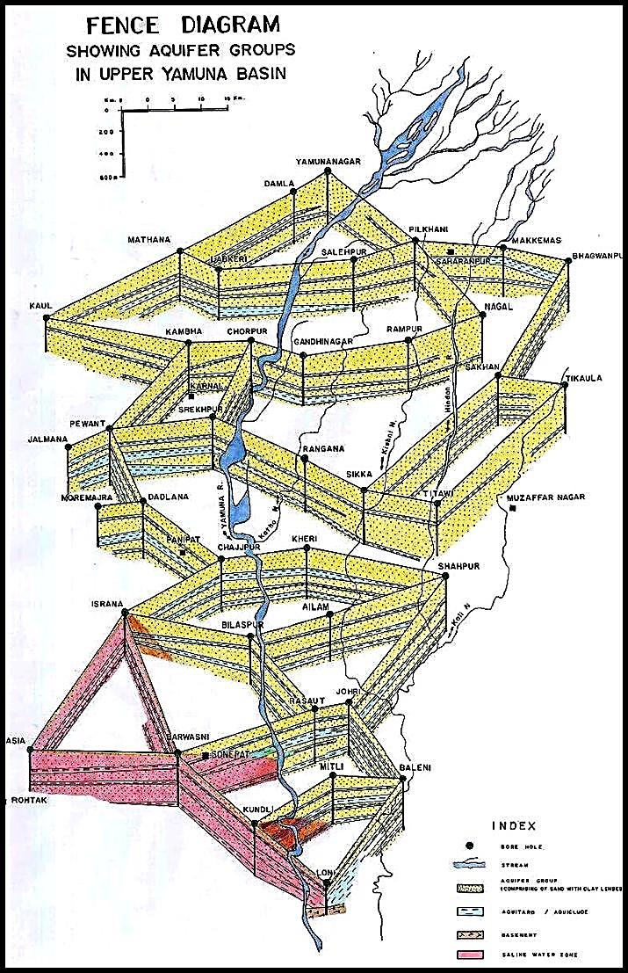
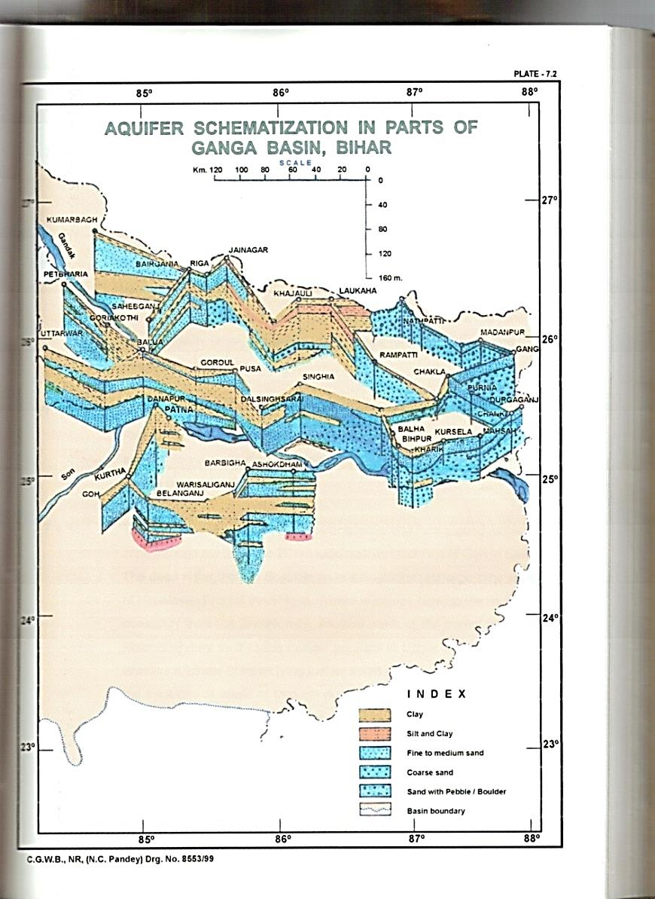
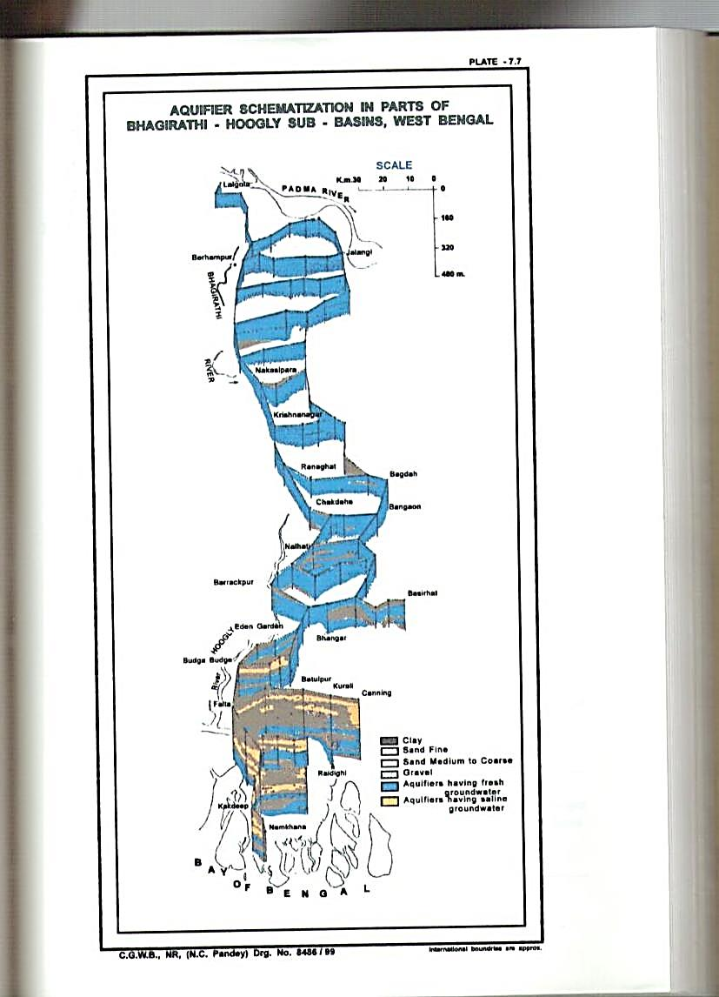
Alluvial Aquifer Disposition in Northern Parts of INDIA

Slide 6
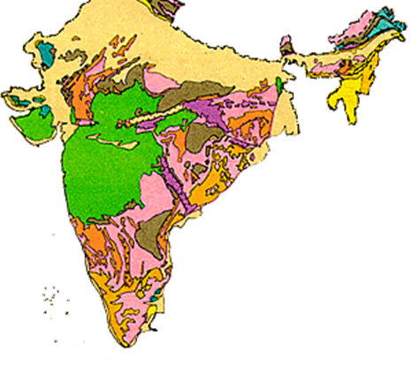
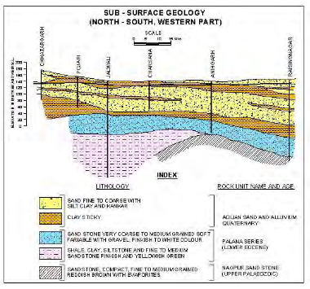
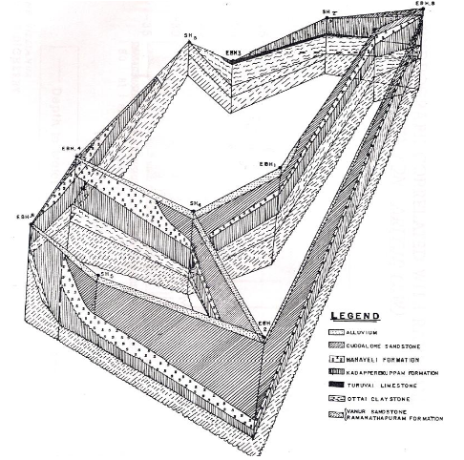
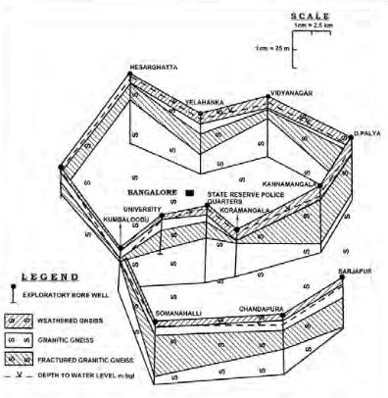
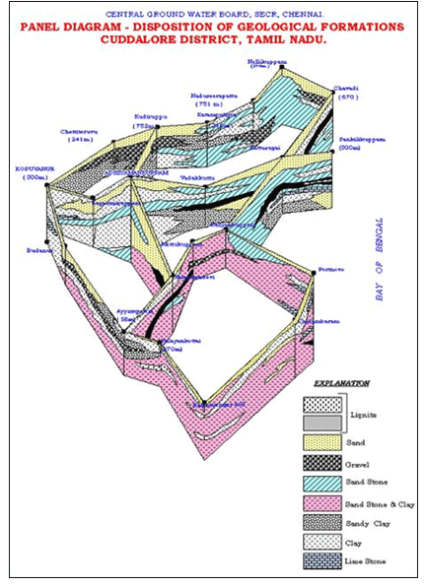
Aquifers Disposition in Central & Southern Parts of INDIA

Slide 7
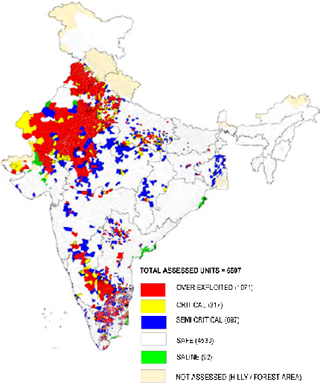
CATEGORIZATION OF ASSESSMENT UNITS
( as on 31.3.2011)
 | 2011
Annual Replenishable GW Resources | 433 bcm
Net Annual Ground Water Availability | 398 bcm
Annual GW Draft for all Uses | 245 bcm
Stage of GW Development | 62%
Categorization of Blocks / Mandals/ Talukas
Total Assessed units | 6607
Safe | 4530 (69%)
Semi-Critical | 697 (11%)
Critical | 217 (3%)
Over-Exploited | 1071 (16%)
Saline | 92 (1.4%)

Slide 8
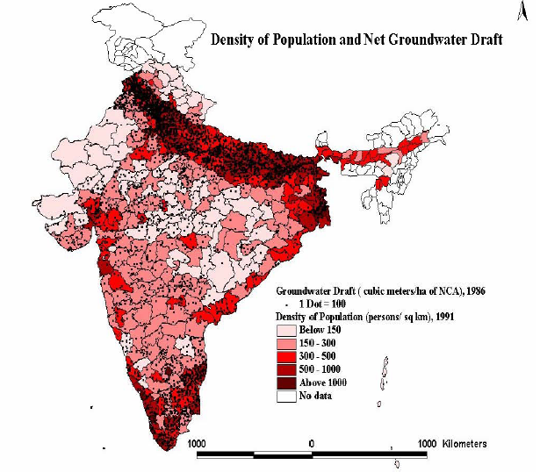
Status of Groundwater Development
Groundwater extraction 240 billion cubic meters per year

Slide 9
Region-wise availability of Ground Water in India (As on 2011)
Regions | Annual Replenishable Ground Water Resource (BCM) | Net Annual Ground Water Availability (BCM) | Annual Ground Water Draft (BCM) | Stage of Ground Water Development (%) | Total Assessment units | Over-exploited units Nos | Critical units Nos
1 | 3 | 4 | 5 | 6 | 7 | 8 | 9
Northern Himalayan States | 6.85 | 6.36 | 2.32 | 36 | 40 | 1 | 4
North Eastern Hilly States | 38.48 | 34.829 | 3.708 | 11 | 126 | 0 | 0
Eastern Plain States | 118.41 | 109.44 | 59.94 | 55 | 1502 | 49 | 45
North Western Plain States | 56.54 | 51.25 | 65.99 | 135 | 497 | 261 | 45
Western arid States | 30.53 | 28.44 | 26.71 | 94 | 468 | 197 | 29
Central Plateu States | 100.03 | 94.40 | 44.47 | 47 | 1244 | 41 | 8
Southern Peninsular States | 81.58 | 73.15 | 41.88 | 57 | 2685 | 522 | 86
Islands | 0.32 | 0.29 | 0.02 | 5 | 45 | 0 | 0
Grand Total | 432.75 | 398.16 | 245.05 | 62 | 6607 | 1071 (16.21%) | 217 (3.28%)
Northern Himalayan States- Himachal Pradesh Jammu&Kashmir, Uttarakhand
North Eastern Hilly States- Arunachal Pradesh,Assam, Manipur, Meghalaya, Mizoram, Nagaland, Sikkim, Tripura
Eastern Plain States- Bihar, Orissa ( Eastern Part),Eastern Uttar Pradesh, West Bengal
North Western Plain States-Delhi ( 137%), Haryana ( 133%), Punjab ( 172%), Western Uttar Pradesh ( 95%),
Western arid States- Gujarat, Rajasthan, Daman&Diu
Central Plateu States- Chhattishgarh, Jharkhand, Madhya Pradesh, Odisha ( Central part), Maharashtra, Dadra & Nagar Haveli
Southern Peninsular States- Andhra Pradesh, Telengana, Goa, Karnataka, Kerala, Tamil Nadu, Pondicherry
Islands- Andaman &Nicobar, Lakshadweep

Slide 10
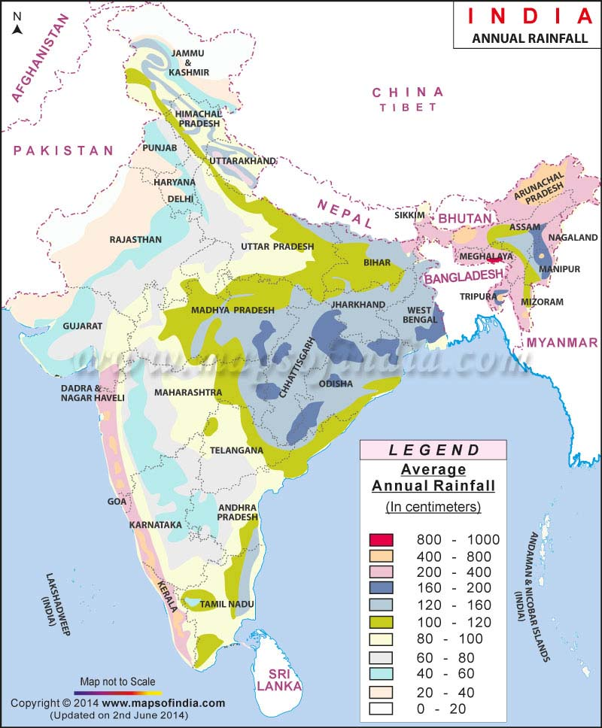
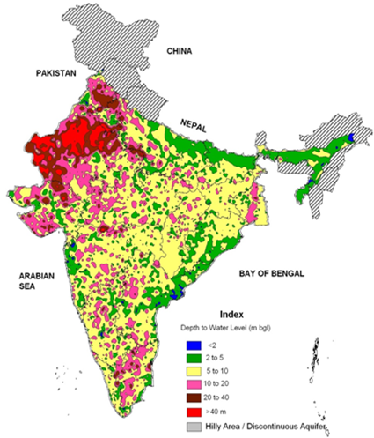
Rainfall
Pre Monsoon Depth to water Level

Slide 11
State-wise Over-Exploited Assessment Units (Major States)
States / UTs | Over-exploited units
Andhra Pradesh | 41/662
Telangana | 42/ 448
Delhi | 18/ 27
Gujarat | 24/ 223
Haryana | 71/ 116
Karnataka | 63/270
Madhya Pradesh | 24/313
Punjab | 110/ 138
Rajasthan | 172/ 243
Tamil Nadu | 374/ 1129
Uttar Pradesh | 111/ 820
Total | 1050/ 4389

Slide 12
REASONS FOR GROUND WATER LEVEL DECLINE
Increasing demand of ground water for agriculture, industrial and drinking purposes.
Change in cropping pattern and growing of paddy and cash crops that consume large quantities of water.
Scanty rainfall in arid and semi-arid regions.
Large ground water extraction when other sources of water are fully committed.
Flat rate/ free electricity for extracting ground water in certain States.
Rapid pace of urbanization resulting in reduced natural recharge to aquifers.

Slide 13
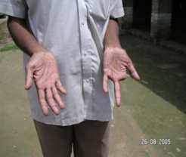
Status of Groundwater Water Quality in India
Arsenicosis
Ground Water Quality issues
Dental fluorosis
Chemical Constituents | No. of States | No. of Districts ( in Parts)
Arsenic | 10 | 86
Fluoride | 20 | 276
Nitrate | 21 | 387
Iron | 24 | 297
Skeletal fluorosis
Localized areas affected by Heavy Metals, Pesticides due to Industrial effluents / Sewage , Mining and overuse of Agricultural inputs

Slide 14
Areas affected by Nitrate
S. | State/UT | No Of District
No. |  | (above 45 mg/l)
1 | Andhra Pradesh | 13
2 | Telangana | 10
3 | Assam | 0
4 | Bihar | 10
5 | Chhattisgarh | 12
6 | Delhi | 8
7 | Gujarat | 22
8 | Haryana | 19
9 | Himachal Pradesh | 6
10 | Jammu & Kashmir | 4
11 | Jharkhand | 11
12 | Karnataka | 22
13 | Kerala | 11
14 | Madhya Pradesh | 50
15 | Maharashtra | 30
16 | Orissa | 28
17 | Punjab | 20
18 | Rajasthan | 33
19 | Tamil Nadu | 27
20 | Uttar Pradesh | 46
21 | Uttarakhand | 3
22 | West Bengal | 2
 | Total no of districts | 387

Slide 15
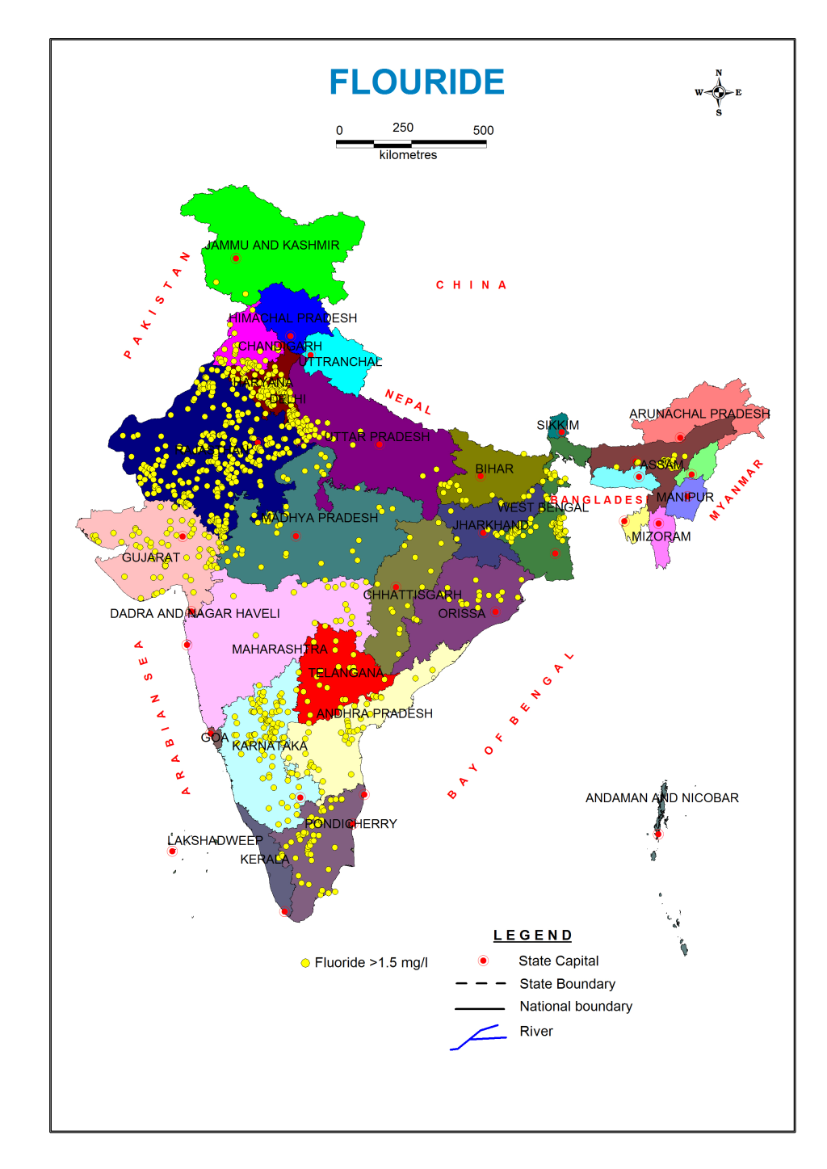
Areas affected by Flouride
S. No. | State/UT | No of District with Fluoride ( above 1.5 mg/l)
1 | Andhra Pradesh | 11
2 | Telangana | 9
3 | Assam | 6
4 | Bihar | 12
5 | Chhattisgarh | 13
6 | Delhi | 7
7 | Gujarat | 19
8 | Haryana | 18
9 | Jammu & Kashmir | 2
10 | Jharkhand | 7
11 | Karnataka | 21
12 | Kerala | 5
13 | Madhya Pradesh | 32
14 | Maharashtra | 13
15 | Orissa | 15
16 | Punjab | 16
17 | Rajasthan | 30
18 | Tamil Nadu | 18
19 | Uttar Pradesh | 13
20 | West Bengal | 9
 | Total no of districts | 276

Slide 16
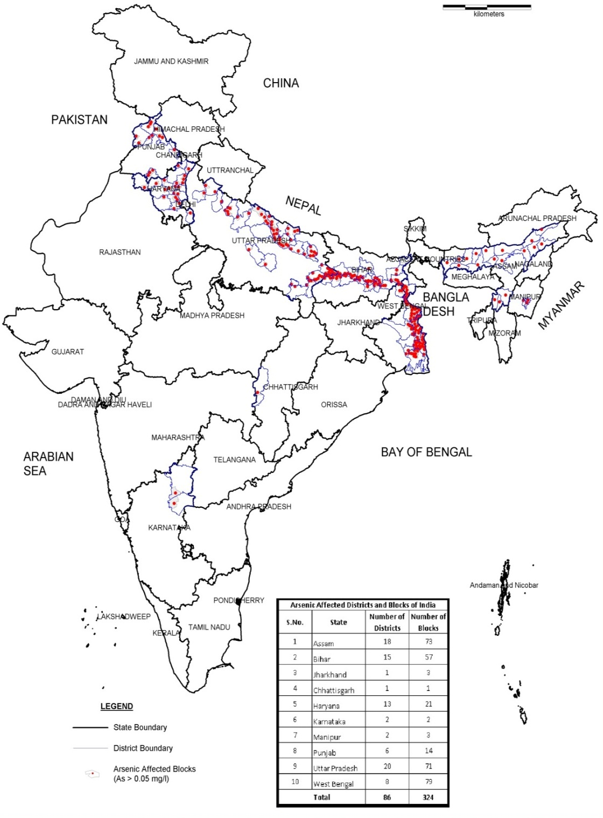
Areas affected by Arsenic

Slide 17
Challenges in GW Management in India
Indiscriminate Groundwater withdrawal leading to:
Increase in Over Exploited & Critical assessment units
Deterioration in GW quality.
Sea water ingress in coastal areas.
Drying up of Shallow Wells
Decrease in base flow in many small rivers
Increased Energy Consumption in withdrawal of groundwater with lowering of water tables
Increase of CO2 emission footprints due to electric & diesel pump sets
Private Ownership of more than 30 million groundwater abstraction structures
Inadequate Regulatory Measures on limit of groundwater withdrawal
Dove tailing community participation in GW Management
Inadequate Institutional mechanism at State level

Slide 18
National Water Policy 2012
Ground Water related issues | Initiatives
Declining ground water levels in over-exploited areas need to be arrested | Notification of 162 areas for control and regulation of ground water; In over-Exploited areas regulation by mandatory artificial recharge. Preparation of plan for recharge in OE/Critical Areas
Artificial recharge projects should be undertaken so that extraction is less than the recharge. | Model designs for artificial recharge structures shared with Stakeholders/ MANREGA Master Plan for Artificial Recharge placed in public domain; States pursued to implement artificial recharge schemes
All Hydrological data other than classified should be in public domain | Ground water data disseminated through CGWB website and WRIS.
Mapping of aquifers to know the quantum and quality of ground water resources. | Initiated Aquifer Mapping in 8.89 lakh sq.km area; Over-exploited/declining water level areas given priority. Data gap analysis completed in about 8 lakh sq. km;

Slide 19
STATUS OF GROUNDWATER GOVERNANCE IN INDIA
Indian Easement Act, 1982 deems groundwater to be an easement connected to the land and grants landowners an unrestricted right to use the groundwater below the land.
Article 246 of the Indian Constitution places water resources in the legislative jurisdiction of the States.
Water supplies, irrigation, canal, drainage and embankments, water storage & water power are under the purview of states
There is no provision in Article 246 of the constitution to grant power to States to legislate on environmental matters, reserving the area of law for the Central government via the reserve clause of Article 248
Groundwater development in the country is largely managed by stakeholders to meet their water demands by installing tubewells on their lands.

Slide 20
1. STATES WHERE LEGISLATION FOR REGULATION OF GROUND WATER DEVELOPMENT HAS BEEN ENACTED
Initiatives of Govt. of India
Circulation of Model Bill on Groundwater Development and Management
S.No. | STATES/ UTs | S.No. | STATES/ UTs
1. | Andhra Pradesh | 8. | Jammu & Kashmir
2. | Assam | 9. | Karnataka
3. | Bihar | 10. | Kerala
4. | Chandigarh | 11. | Lakshadweep
5. | Dadra & Nagar Haveli | 12. | Maharashtra
6. | Goa | 13. | Puducherry
7. | Himachal Pradesh | 14 | West Bengal
 |  | 15. | Telangana

Slide 21
2. STATES WHERE INITIATIVES TAKEN FOR ENACTMENT OF MODEL BILL
S.No. | STATES/ UTs | S.No. | STATES/ UTs
1. | Andaman & Nicobar | 9. | Meghalaya
2. | Chhattisgarh | 10. | Mizoram
3. | Daman & Diu | 11. | Odisha
4. | NCT Delhi | 12. | Rajasthan
5. | Gujarat | 13. | Uttaranchal
6. | Haryana | 14. | Uttar Pradesh
7. | Jharkhand | 15. | Punjab
8. | Madhya Pradesh | 16. | Tamil Nadu
3. STATES/UTs WHICH DO NOT FEEL THE NEED FOR ENACTMENT OF LEGISLATION
1. | Arunachal Pradesh
2. | Manipur
3. | Nagaland
4. | Sikkim
5. | Tripura

Slide 22
Groundwater Regulation in India
Constitution of Central Ground Water Authority (CGWA)
CGWA has been vested with powers of penal provisions contained in sections 15 to 21 of the Environment (Protection) Act, 1986 to enforce its regulatory directions.
The mandate of CGWA is primarily focused on ground water regulation to curb over-exploitation of resource and mandate of Water Quality Assessment Authority (WQAA) is focussed on quality of both surface and ground water.

Slide 23
S. No. | STATE / UT | No. Block/ Mandal/ Taluka / Areas Notified by CGWA
1. | Andhra Pradesh | 5
2. | Telangana | 2
3. | Diu | 1
4. | Gujarat | 4
5. | Haryana | 17
6. | Karnataka | 22
7. | Madhya Pradesh | 7
8. | NCT, Delhi | 3
9. | Pudducherry | 1
10. | Punjab | 45
11. | Rajasthan | 35
12. | Tamil Nadu | 18
13. | Uttar Pradesh | 1
14. | West Bengal | 1
 | Total | 162
Areas Notified by CGWA

Slide 24
Management Initiatives

Slide 25
Aquifer mapping & managment
Description
A native description of maps
Groundwater Management strategies
Location specific protocols and agreements
Artificial recharge programs
Sustainable yield management goal
For the aquifers, stating that the average withdrawals should not exceed long-term recharge, at least as a guiding principal
Inputs / guidance for implementing artificial recharge programmes effectively, indicating plans for implementing artificial recharge for the aquifers concerned.
aquifer mapping must lead to a groundwater management strategy, which includes appropriate demand-management strategies in addition to water use and recharge.
Aquifer mapping should lead to location-specific protocols and agreements within the user community as well help arrive at a robust regulatory framework through legislation.
Central Ground Water Board (CGWB), Ministry of Water Resources, Govt. of India

Slide 26
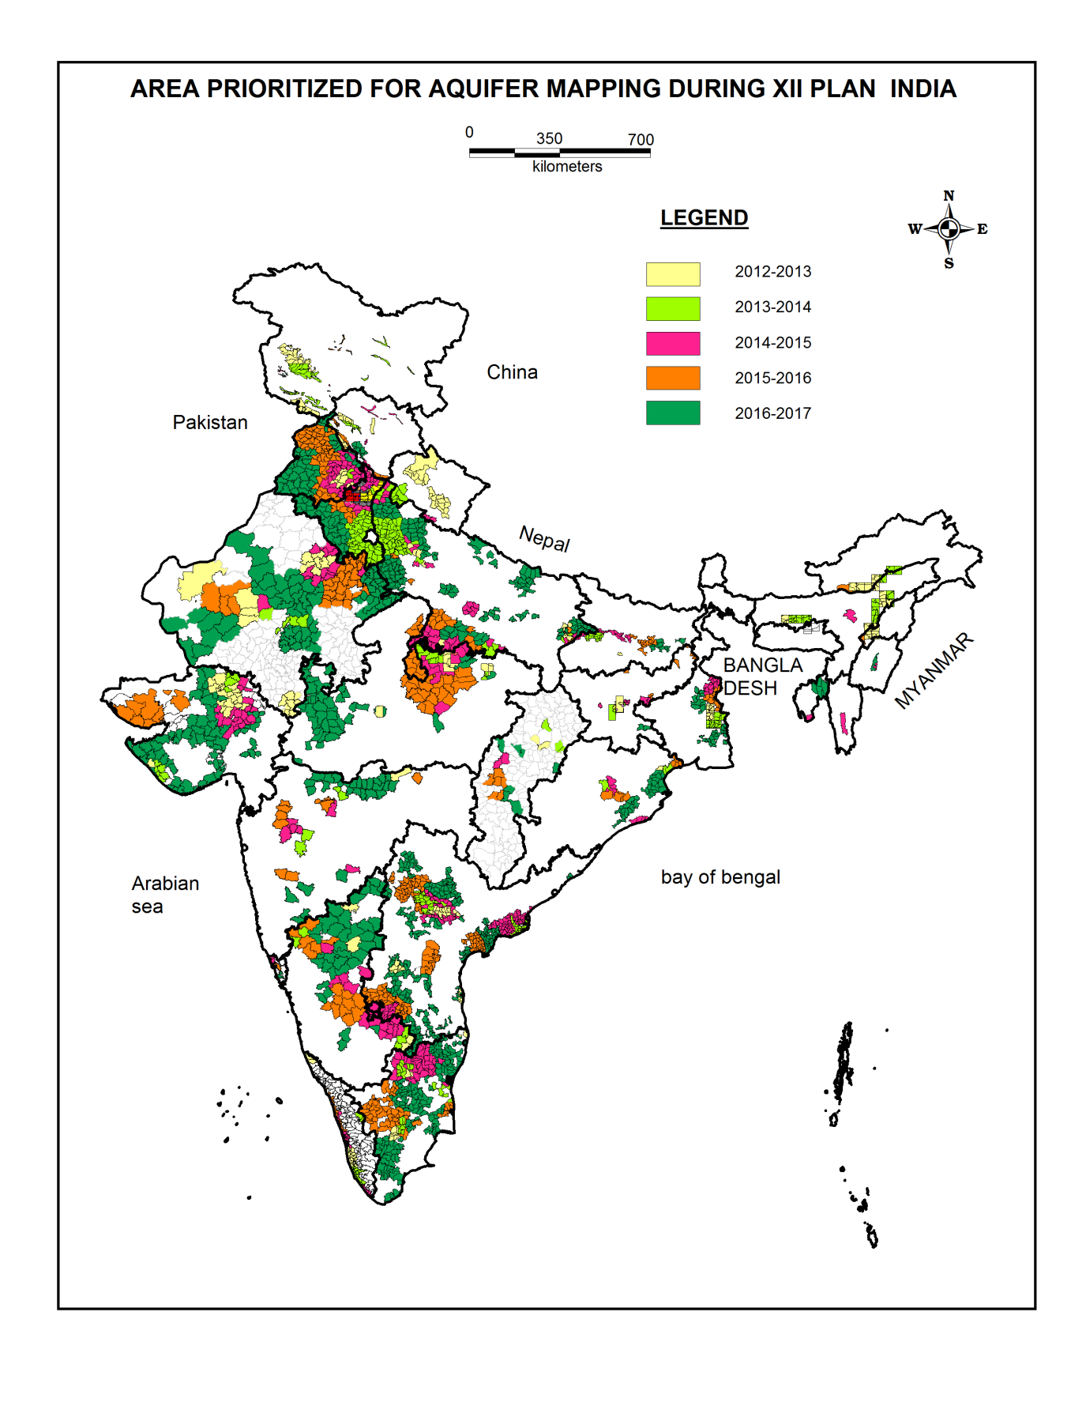
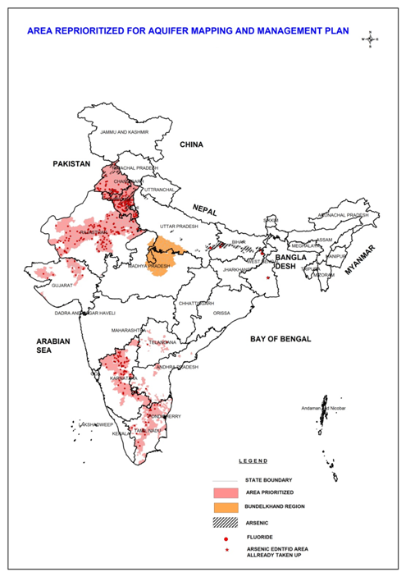

Slide 27
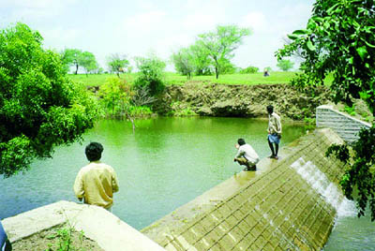
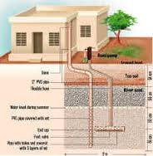
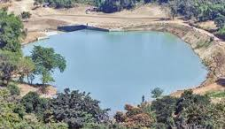
GROUNDWATER RECHARGE AS RESOURCE MANAGEMENT TOOL

Slide 28
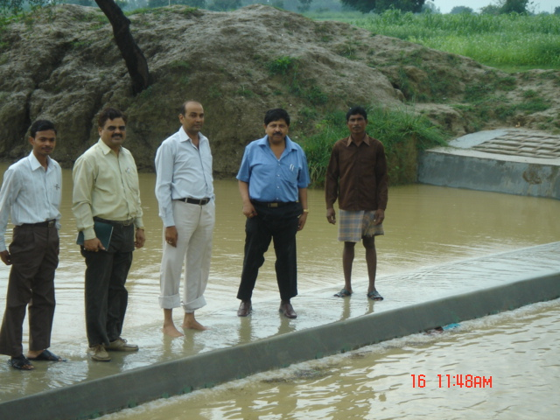
Highlights of Artificial Recharge and Water Conservation Project, Sataon block, Uttar Pradesh
Bingh Check Dam

Slide 29
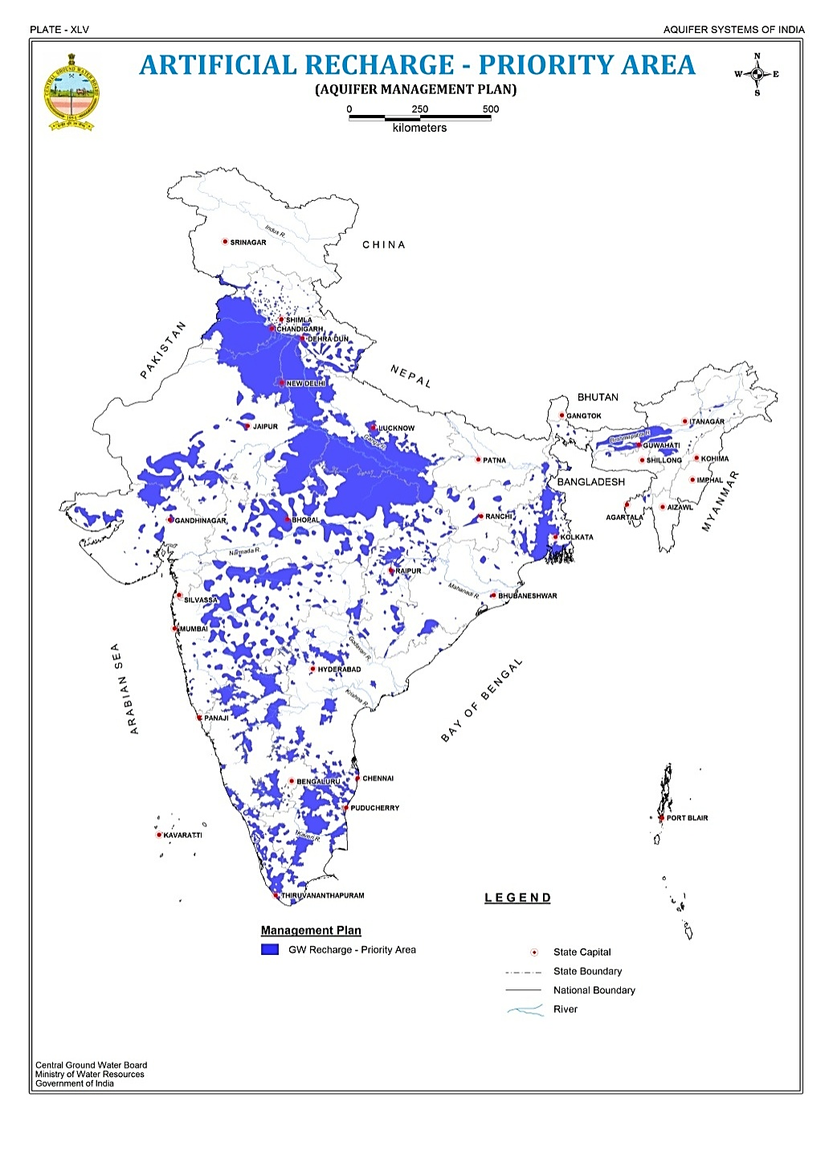
Master Plan of Artificial Recharge to Ground Water (2013)
Area suitable for Artificial Recharge | 9,41,541 Sq Km.
Volume of Water Available for recharge | 85,565 Million Cubic Meter (MCM)
No. of Recharge Structures | 1.11 crore
Estimated Cost | INR 79,178 Crore

Slide 30
State/UT-wise areas identified for Artificial Recharge under Master Plan
SN | State | Area (Sq Km)
1 | Andhra Pradesh | 24078
2 | Bihar | 760.3
3 | Chhattisgarh | 22401.4
4 | Delhi | 699.86
5 | Goa | 2027
6 | Gujarat | 19407
7 | Haryana | 37029
8 | Himachal Pradesh | 2500
9 | Jammu & Kashmir | 5000
10 | Jharkhand | 7864
11 | Karnataka | 74007
12 | Kerala | 10849
13 | Madhya Pradesh | 119409
14 | Maharashtra | 130011
15 | NER states | 25508
S N | State | Area (Sq Km)
16 | Odisha | 5339
17 | Punjab | 43340
18 | Rajasthan | 160589
19 | Sikkim | 500
20 | Tamil Nadu | 68839
21 | Telengana | 19665
22 | Uttar Pradesh | 110783
23 | Uttarakhand | 13542
24 | West Bengal | 36730.4
25 | A & N Island | 200
26 | Chandigarh | 100
27 | D& N Haveli | 50
28 | Daman and Diu | 10
29 | Lakshadweep | 3
30 | Puducherry | 300

Slide 31
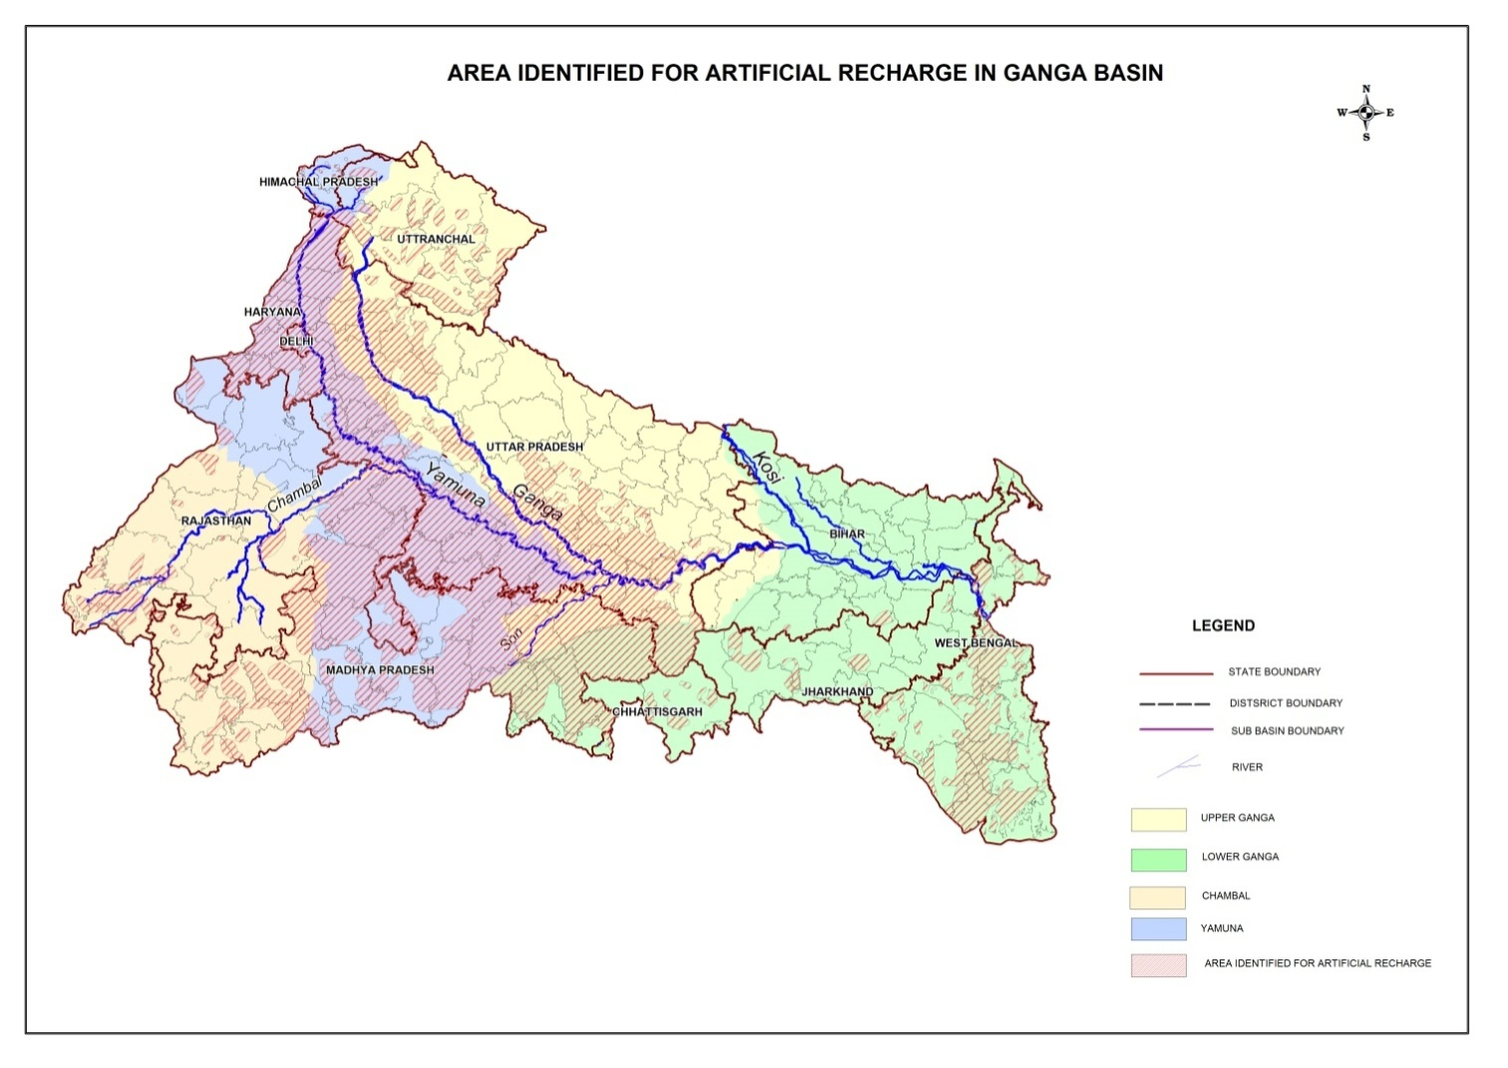
Fig-7

Slide 32
Extent of States in Ganga Basin and Areas Feasible For Artificial Recharge
S. No. | STATE_NAME | Total area (km²) Source: Census, 2011) | Area Falling in Ganga Basin (in km²) | Area suitable for Artificial Recharge (km²)
1 | BIHAR | 94163 | 94163 | 760
2 | CHHATTISGARH | 135192 | 18378 | 2646
3 | DELHI | 1483 | 1483 | 700
4 | HARYANA | 44212 | 16618 | 12419
5 | HIMACHAL PRADESH | 55673 | 6390 | 400
6 | JHARKHAND | 79716 | 50709 | 6990
7 | MADHYA PRADESH | 308252 | 181720 | 99963
8 | RAJASTHAN | 342239 | 108852 | 39139
9 | UTTAR PRADESH | 240928 | 240928 | 110783
10 | UTTARAKHAND | 53483 | 53483 | 13542
11 | WEST BENGAL | 88752 | 74028 | 36730
 | Total | 1444093 | 846752 | 324072

Slide 33
Groundwater Governance
Issues & Challenges
The XII plan Document elaborates
“While ground water resources are perceived as a part of a specific cadaster , might be hydrological ( eg. watersheds, landscape, river basins) or administrative ( Villages, blocks etc.) Aquifers are seldom considered.”
Despite various Government Initiatives and efforts by CGWB (and work by Some state departments and civil society organization) aquifer as groundwater bearing unites never found a place in mainstream thinking on management of groundwater resources.
The current approach tends to ignore the common pool nature of ground water .
The delinking of groundwater from land ownership and change in property rights regime from an ownership to a trusteeship paradigm must begin with Aquifer based ground water management programmes.

Slide 34
Central Ministries dealing with GW
Water Resources, River Development and Ganga Rejuvenation.
Agriculture
Environment, Forests and Climate Change.
Rural Development
Urban Development
Panchayati Raj
Earth Sciences
Science & Technology

Slide 35
Observations
Punjab :
The Deficit between present GW withdrawal and availability : 15.56 BCM
GW Recharge Possibility : 1.20 BCM ( 7.7 % of Deficit)
Cost of Recharge : 2,021 Crore
it may not improve GW situation and is not Total solution
Rajasthan :
The Deficit between present GW withdrawal and availability : 4.01 BCM
GW Recharge Possibility : 0.86 BCM (21 % of Deficit)
Cost of Recharge : 1,566 Crore
Localized improvement in GW situation may take place
Haryana :
The Deficit between present GW withdrawal and availability : 3.26 BCM
GW Recharge Possibility : 0.68 bCM ( 21 % of Deficit)
Cost of Recharge : 1,255 Crore
Localized improvement in GW situation may take place
Tamiul nadu :
No Deficit between present GW withdrawal and availability :
GW Recharge Possibility : 0.71 bCM
Cost of Recharge : 92.85 Crore
Localized improvement in GW situation may take place
Possibility of GW Recharge and Possible GW Improvement Scenarios
(Master Plan , 2013, Excluding RTRWH)
S.N. | State /UT | total Area (sq.km) | Area feasible for art. rech.(sq.km) | unsat. zone avail. for rech.(MCM) | Vol. of water requir. for rech.(MCM) | surpl. water avail. for rech.(MCM) | Propos. Struct. | Tent. Cost ( lakh) | Net GW Avialbility (BCM) | Total Draft(BCM) | Stage of Dev.(%) | Difference bet. Net Avail. Res. and Draft ( BCM)
1 | 2 | 3 | 4 | 5 | 6 | 7 | 9 | 10 | 11 | 12 | 13 | 14
1 | Punjab | 50362 | 43340 | 52684 | 70071 | 1201 | 79924 | 202147 | 20.32 | 35.88 | 172 | -15.6
2 | Rajasthan | 342239 | 160589 | 2724364 | 264109 | 860 | 9593 | 156600 | 10.83 | 14.84 | 137 | -4.0
3 | Tamil Nadu | 130058 | 68839 | 215937 | 5982 | 712 | 193574 | 9285 | 19.39 | 14.93 | 77 | 4.5
4 | Haryana | 44212 | 37029 | 54175 | 72053 | 679 | 44727 | 125530 | 9.79 | 13.05 | 133 | -3.3

Slide 36
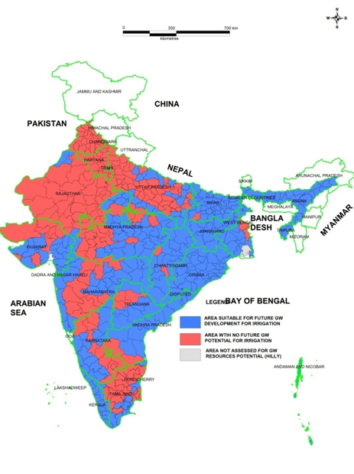
FURTHER SCOPE FOR GROUNDWATER DEVELOPMENT FOR IRRIGATION IN AGRICULTURE

Slide 37
ALLOCATION OF GROUNDWATER RESOURCES
Replenishable Groundwater resources need to be allocated as :
20% Drinking, Industrial, infrastructural & Commercial uses
20% Ecological needs
60% Irrigation Sector
Focus on development of groundwater in safe blocks

Slide 38
Protection of Potential recharge zone
Areas with promising natural recharge zones need to be protected from urban development
Runoff conservation in watersheds with participatory approach
Demarcating aquifers as Groundwater Sanctuary for disaster management
Protection of coastal aquifers from salinity ingress by protected development & recharge
Conjunctive use of surface water, rainwater & groundwater in irrigation sector

Slide 39
STEPS TOWARDS SUSTAINABLE IN GROUNDWATER MANAGEMENT
Prioritizing groundwater development depending upon availability of groundwater resources instead of demand-driven approach
Reallocation of groundwater for irrigation as well as other growing sectors
Guidelines on groundwater withdrawal and implementation of recharge measures by stakeholders
Adoption of water use efficiency techniques
Need-based regulatory measures in over-exploited areas.

Slide 40
WAY TO GROUNDWATER REFORM
Information generation through scientific techniques on aquifer disposition and vulnerability to generate models for aquifer-based development of groundwater
Aquifer-wise groundwater management by involving stakeholders in participatory approach.
Public sector investment in groundwater by bringing schemes of groundwater development and artificial recharge in groundwater potential areas and over-exploited areas
Area-specific implementation of regulation by standardizing depth of tubewells for various user sectors, distance between two wells, discontinuing free energy for irrigation.

Slide 41
Thanks

Slide 42
Central Ground Water Board MINISTRY OF WATER RESOURCES, RIVER DEVELOPMENT AND GANGA REJUVENATION
National Apex Organization to provide scientific inputs for GW development and management.
Vision
“Sustainable Development and Management of Ground Water Resources of the Country”
Mandate
" Develop and disseminate technologies, and monitor and implement national policies for the Scientific and Sustainable development and management of India's Ground Water Resources, including their exploration, assessment, conservation, augmentation, protection from pollution and distribution, based on principles of economic and ecological efficiency and equity."

Slide 43
Average Annual Rainfall INDIA
Pre monsoon Depth to Water Level Map-2014

Slide 44
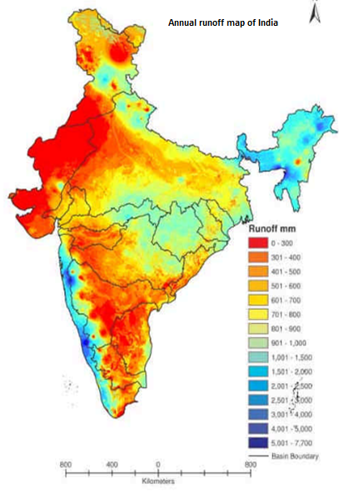
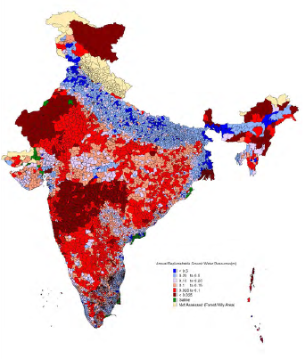
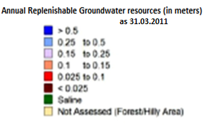
ANNUAL NATURAL RECHARGE TO GROUNDWATER

Slide 45
STATE-WISE GROUND WATER RESOURCES AVAILABILITY, UTILIZATION AND STAGE OF DEVELOPMENT INDIA (as on 2011)

Slide 46
Runoff calculation norms in India
BY runoff Formulae and tables
Runoff coefficient
Inglis formula
Khosla’s Formula
SCS curve number method
Runoff by infiltration method
Rational Method

Slide 47
Pilot & Demonstrative Rain Water Harvesting & Artificial Recharge Projects
CGWB implemented rainwater harvesting & recharge projects for capacity building of State Government Agencies and establishing the efficacy of recharge structures in different hydrgeomorphic terrains of the country
Implemented during VIII (1992-1997) Plan
No of Projects – 14, Implemented in 9 States
No of Structures – 62, Cost of Project – 3.23 Cr
Quantum of Recharge – 4.0 MCM
Implemented during IX (1997-2002) Plan
No of Projects – 165, Implemented in 27 States
No of Structures – 679, Cost of Project – 33.31 Cr
Quantum of Recharge – 45 MCM
Implemented during X (2002-2007) Plan
No of Projects – 8, Implemented in 4 States
No of Structures – 197, Cost of Project – 5.6 Cr
Quantum of Recharge – 2.14 MCM
Implemented during XI (2007-2012) Plan
No of Projects – 133, Implemented in 22 States
No of Structures – 1537 , Cost of Project – 99.87 Cr
Quantum of Recharge – 55.20 MCM

Slide 48
State Wise Summarized Details of Artificial Recharge Structures

Slide 49
S.N. | State /UT | Area(sq.km) | Area feasible for artificial recharge(sq.km) | Volume of unsaturated zone available for recharge(MCM) | Volume of water required for recharge(MCM) | Volume of surplus local/ distant source available for recharge(MCM) | Volume of water to be harnessed(MCM) | Volume of water to be harnessed through RTRWH(MCM) | Types of artificial recharge structures feasible Number
1 | 2 | 3 | 4 | 5 | 6 | 7 | 8 | 9 | 10
1 | Andhra Pradesh | 275068 | 43743 | 340500 | 10215 | 2302.97 | 2302.97 | 120.53 | CD - 28787
 |  |  |  |  |  |  |  |  | P - 3838
 |  |  |  |  |  |  |  |  | RS - 34000
 |  |  |  |  |  |  |  |  | RTW - 2000
 |  |  |  |  |  |  |  |  | RTRWH(H) - 712500
 |  |  |  |  |  |  |  |  | RTRWH(G & I)-37500
2 | Bihar | 94163 | 760.3 | 4406.2 | 215.9 | 83.14 | 83.14 | 23.13 | P - 277
 |  |  |  |  |  |  |  |  | RS - 118
 |  |  |  |  |  |  |  |  | NB - 1663
 |  |  |  |  |  |  |  |  | RTRWH(H) - 95000
 |  |  |  |  |  |  |  |  | RTRWH(G & I)- 5000
3 | Chhattisgarh | 136034 | 22401.4 | 85343.58 | 2902.72 | 37783.48 | 2902.72 | 52.07 | P - 4729
 |  |  |  |  |  |  |  |  | NB & CD - 15862
 |  |  |  |  |  |  |  |  | G - 38062
 |  |  |  |  |  |  |  |  | RS - 28549
 |  |  |  |  |  |  |  |  | RTRWH(H) - 190000
 |  |  |  |  |  |  |  |  | RTRWH(G & I)- 10000
4 | Delhi | 1483 | 699.86 | 10153.56 | 853.83 | 24.39 | 24.39 | 14.69 | RS - 17850
 |  |  |  |  |  |  |  |  | CD - 8
 |  |  |  |  |  |  |  |  | RTRWH(H) - 118750
 |  |  |  |  |  |  |  |  | RTRWH(G & I) - 6250
5 | Goa | 3702 | 2027 | 14191 | 866 | 528.69 | 528.69 | 5.76 | Vented Dam - 1393
 |  |  |  |  |  |  |  |  | RTRWH(H) - 9500
 |  |  |  |  |  |  |  |  | RTRWH(G & I) - 500
6 | Gujarat | 196024 | 19407 | 109668 | 10708 | 1483.54 | 1483.54 | 110.4 | P - 1800
 |  |  |  |  |  |  |  |  | CD - 16975
 |  |  |  |  |  |  |  |  | RTRWH(H) - 475000
 |  |  |  |  |  |  |  |  | RTRWH(G & I) 25000
7 | Haryana | 44212 | 37029 | 54175 | 72053 | 679.26 | 679.26 | 187 | CD - 335
 |  |  |  |  |  |  |  |  | RS - 44392
 |  |  |  |  |  |  |  |  | Rech. Sewage - 1000
 |  |  |  |  |  |  |  |  | RTRWH(H) - 300000
 |  |  |  |  |  |  |  |  | RTRWH(G & I)- 75000
8 | Himachal Pradesh | 55673 | 2500 | 105000 | 1775 | 1775 | 1775 | 13 | G - 98775
 |  |  |  |  |  |  |  |  | CD/NB -1849
 |  |  |  |  |  |  |  |  | SSD - 347
 |  |  |  |  |  |  |  |  | CD/SSD - 684
 |  |  |  |  |  |  |  |  | RS - 542
 |  |  |  |  |  |  |  |  | I - 131
 |  |  |  |  |  |  |  |  | RTRWH(H) - 47500
 |  |  |  |  |  |  |  |  | RTRWH(G & I) - 2500
9 | Jammu and Kashmir | 222236 | 5000 | 185000 | 1688 | 29173 | 1688 | 12 | CD - 1000
 |  |  |  |  |  |  |  |  | Pond - 688
 |  |  |  |  |  |  |  |  | RTRWH(H) - 95000
 |  |  |  |  |  |  |  |  | RTRWH(G & I)- 5000
10 | Jharkhand | 79714 | 7864 | 24935.16 | 1414.31 | 4042 | 1414.31 | 47.56 | P - 3754
 |  |  |  |  |  |  |  |  | NB - 22528
 |  |  |  |  |  |  |  |  | RTRWH(H) - 190000
 |  |  |  |  |  |  |  |  | RTRWH(G & I)- 10000

Slide 50
S.N. | State /UT | Area(sq.km) | Area feasible for artificial recharge(sq.km) | Volume of unsaturated zone available for recharge(MCM) | Volume of water required for recharge(MCM) | Volume of surplus local/ distant source available for recharge(MCM) | Volume of water to be harnessed(MCM) | Volume of water to be harnessed through RTRWH(MCM) | Types of artificial recharge structures feasible Number
11 | Karnataka | 191791 | 74007 | 427424 | 11367 | 17122 | 11367 | 167.73 | SSD - 271
 |  |  |  |  |  |  |  |  | P - 10166
 |  |  |  |  |  |  |  |  | CD - 59853
 |  |  |  |  |  |  |  |  | PR – 2695
 |  |  |  |  |  |  |  |  | RTRWH(H) - 665000
 |  |  |  |  |  |  |  |  | RTRWH(G & I - 35000
12 | Kerala | 38863 | 10849 | 42607 | 1520 | 17678 | 1520 | 181.44 | P - 3109
 |  |  |  |  |  |  |  |  | CD - 3032
 |  |  |  |  |  |  |  |  | SSD - 832
 |  |  |  |  |  |  |  |  | NB - 54957
 |  |  |  |  |  |  |  |  | CB - 106173
 |  |  |  |  |  |  |  |  | I - 45
 |  |  |  |  |  |  |  |  | GP - 586279
 |  |  |  |  |  |  |  |  | RTRWH(H) - 299250
 |  |  |  |  |  |  |  |  | RTRWH(G & I)- 15750
13 | Madhya Pradesh | 308144 | 119409 | 16066 | 21368 | 15280 | 15280 | 103.39 | P - 15284
 |  |  |  |  |  |  |  |  | CD - 125019
 |  |  |  |  |  |  |  |  | RS - 125019
 |  |  |  |  |  |  |  |  | NB – 229202
 |  |  |  |  |  |  |  |  | CP - 38200
 |  |  |  |  |  |  |  |  | RTRWH(H) - 570000
 |  |  |  |  |  |  |  |  | RTRWH(G & I)- 30000
14 | Maharashtra | 307713 | 130011 | 260022 | 8474 | 2846 | 2846 | 257.43 | P - 9961
 |  |  |  |  |  |  |  |  | CD - 26924
 |  |  |  |  |  |  |  |  | RS (URBAN)- 5670
 |  |  |  |  |  |  |  |  | RS - 772
 |  |  |  |  |  |  |  |  | GP - 1500
 |  |  |  |  |  |  |  |  | NB/CP - 12,000
 |  |  |  |  |  |  |  |  | RTRWH(H) -1520000
 |  |  |  |  |  |  |  |  | RTRWH(G & I)- 80000
15 | North Eastern States | 255083 | 25508 | 114786 | 5600 | 5600 | 5600 | 114.2 | CD - 2650
 |  |  |  |  |  |  |  |  | NB - 5100
 |  |  |  |  |  |  |  |  | G - 6100
 |  |  |  |  |  |  |  |  | SD - 1400
 |  |  |  |  |  |  |  |  | RTRWH(H) - 380000
 |  |  |  |  |  |  |  |  | RTRWH(G & I) -20000
16 | Odisha | 155707 | 5339 | 1076.31 | 1192.05 | 5538.49 | 1192.05 | 76.66 | P - 1107
 |  |  |  |  |  |  |  |  | ST - 905
 |  |  |  |  |  |  |  |  | SSD - 871
 |  |  |  |  |  |  |  |  | NB - 2265
 |  |  |  |  |  |  |  |  | Wier - 181
 |  |  |  |  |  |  |  |  | Flooding - 121
 |  |  |  |  |  |  |  |  | IR - 22
 |  |  |  |  |  |  |  |  | RS - 384
 |  |  |  |  |  |  |  |  | RTRWH(H) - 285000
 |  |  |  |  |  |  |  |  | RTRWH(G & I) -15000
17 | Punjab | 50362 | 43340 | 52684 | 70071 | 1201 | 1201 | 187 | RS - 79839
 |  |  |  |  |  |  |  |  | CD – 85
 |  |  |  |  |  |  |  |  | RTRWH(H) - 300000
 |  |  |  |  |  |  |  |  | RTRWH(G & I)- 75000
18 | Rajasthan | 342239 | 160589 | 2724364 | 264109 | 860 | 860 | 47.42 | P - 3010
 |  |  |  |  |  |  |  |  | Anicut - 860
 |  |  |  |  |  |  |  |  | RS - 5733
 |  |  |  |  |  |  |  |  | RTRWH(H) - 475000
 |  |  |  |  |  |  |  |  | RTRWH(G & I) 25000
19 | Sikkim | 7096 | 500 | 1000 | 277 | 277 | 91 | 186 | SD - 1400
 |  |  |  |  |  |  |  |  | G/CD/NB - 180
 |  |  |  |  |  |  |  |  | CP/SSD - 325
 |  |  |  |  |  |  |  |  | RTRWH(H) - 4750
 |  |  |  |  |  |  |  |  | RTRWH(G & I)- 250
20 | Tamil Nadu | 130058 | 68839 | 215937.2 | 5982.64 | 712.3 | 712.3 | Nil* | P - 5388
 |  |  |  |  |  |  |  |  | CD/NB - 16163
 |  |  |  |  |  |  |  |  | RS - 154578
 |  |  |  |  |  |  |  |  | RTW - 743
 |  |  |  |  |  |  |  |  | RT(KM)- - 539
 |  |  |  |  |  |  |  |  | FP/RP - 16163

Slide 51
S.N. | State /UT | Area(sq.km) | Area feasible for artificial recharge(sq.km) | Volume of unsaturated zone available for recharge(MCM) | Volume of water required for recharge(MCM) | Volume of surplus local/ distant source available for recharge(MCM) | Volume of water to be harnessed(MCM) | Volume of water to be harnessed through RTRWH(MCM) | Types of artificial recharge structures feasible Number
21 | Uttar Pradesh | 240928 | 110783 | 57831 | 76915 | 5185 | 5185 | 221.18 | P - 3022
 |  |  |  |  |  |  |  |  | NB/CD/CP – 66285
 |  |  |  |  |  |  |  |  | RS/DW/TW – 39638
 |  |  |  |  |  |  |  |  | RTRWH(H) - 1140000
 |  |  |  |  |  |  |  |  | RTRWH(G & I)- 60000
22 | Uttrakhand | 53483 | 13542 | 26311 | 6578 | 14307 | 6578 | 13.67 | P - 450
 |  |  |  |  |  |  |  |  | CD - 2300
 |  |  |  |  |  |  |  |  | RS - 150
 |  |  |  |  |  |  |  |  | RTRWH(H) - 47500
 |  |  |  |  |  |  |  |  | RTRWH(G & I)- 750
23 | West Bengal | 88752 | 36730.4 | 14931 | 17797 | 29803 | 17797 | 100.8 | Hard Rock
 |  |  |  |  |  |  |  |  | P - 1679
 |  |  |  |  |  |  |  |  | CD - 4449
 |  |  |  |  |  |  |  |  | G - 12277
 |  |  |  |  |  |  |  |  | SSD - 5385
 |  |  |  |  |  |  |  |  | RS - 1218
 |  |  |  |  |  |  |  |  | Alluvium
 |  |  |  |  |  |  |  |  | P - 15913
 |  |  |  |  |  |  |  |  | Tank - 41623
 |  |  |  |  |  |  |  |  | I - 14816
 |  |  |  |  |  |  |  |  | RTRWH(H) - 285000
 |  |  |  |  |  |  |  |  | RTRWH(G& I)- 15000
24 | A & N Island | 8293 | 200 | 200 | 95.93 | 95.53 | 95.53 | 0.67 | SD - 150
 |  |  |  |  |  |  |  |  | CD/G/NB - 320
 |  |  |  |  |  |  |  |  | P - 720
 |  |  |  |  |  |  |  |  | SSD - 250
 |  |  |  |  |  |  |  |  | CP - 200
 |  |  |  |  |  |  |  |  | RTRWH(H) - 1150
 |  |  |  |  |  |  |  |  | RTRWH(G & I)- 50
25 | Chandigarh | 114 | 100 | 145 | 193 | 30.71 | 30.71 | 0 | RS - 8700
26 | Dadra & Nagar Haveli | 491 | 50 | 50 | 2.5 | 2.5 | 2.5 | 0.44 | CD/CP - 50
 |  |  |  |  |  |  |  |  | RTW - 15
 |  |  |  |  |  |  |  |  | RTRWH(H) - 950
 |  |  |  |  |  |  |  |  | RTRWH(G & I)- 50
27 | Daman and Diu | 112 | 10 | 10 | 1 | 0.13 | 0 | 0.13 | RTRWH(H) - 3944
 |  |  |  |  |  |  |  |  | RTRWH(G & I) - 100
28 | Lakshadweep | 32 | 3 | 3 | 0.0327 | 0.0327 | 0 | 0.0327 | RTRWH(H) - 4576
 |  |  |  |  |  |  |  |  | RTRWH(G & I) -1524
29 | Puducherry | 479 | 300 | 252 | 80 | 120 | 80 | 0.27 | P - 30
 |  |  |  |  |  |  |  |  | CD/NB - 600
 |  |  |  |  |  |  |  |  | RS - 400
 |  |  |  |  |  |  |  |  | RTW - 500
 |  |  |  |  |  |  |  |  | RT(KM) -- 10
 |  |  |  |  |  |  |  |  | Others - 200
 |  |  |  |  |  |  |  |  | RTRWH(H) - 900
 |  |  |  |  |  |  |  |  | RTRWH(G & I) - 100
Total |  | 3287263 | 941541 | 4890260 | 595472 | 194720 | 83319.11 | 2445.6

